Slide 1
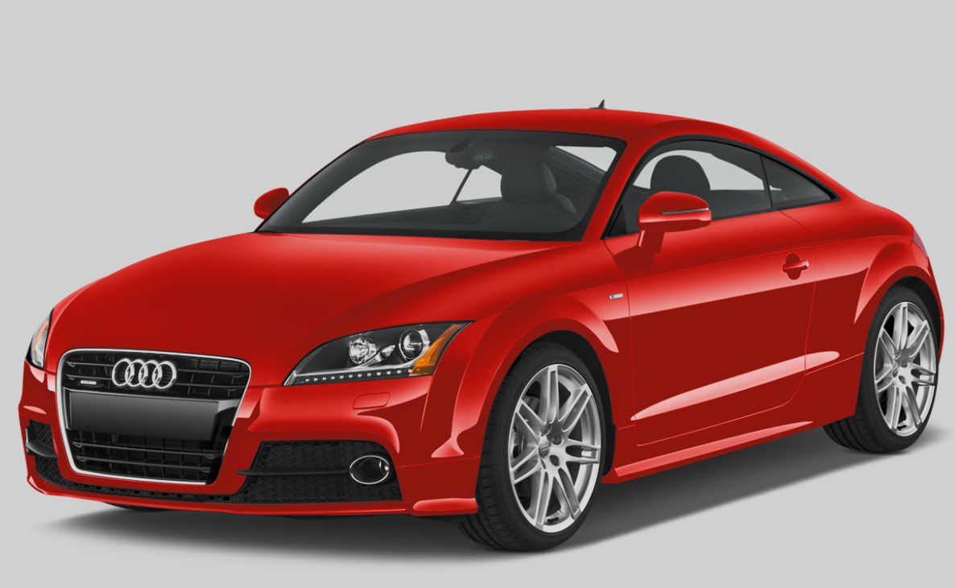
Car Data Analysis
Analysing Price trends, Sales surges and Fuel Efficiency influences
- Prasoon Singh

Slide 2
Contents
Title Slides
Introduction 3
Overview 4
Methods 5-6
Insights 8-15
Summary 16
Challenges 17
Future Work 18

Slide 3
Introduction
Comprehensive Dataset: Dataset provided contains price, fuel, class, model, etc. related info which is analysed to provide insights
Objective: Categorize by price, analyze price changes, study sales dynamics, and explore fuel efficiency impacts.
Significance
Illuminate industry trends.
Empower strategic decision-making.
Drive innovation and adaptability.
Panoramic view of automotive landscape.

Slide 4
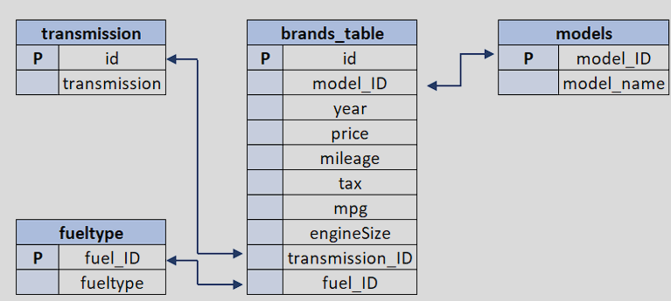
Overview of Dataset
Key Columns
Price: Core metric for categorization and trend analysis.
Fuel Efficiency: Key factor in exploring its impact on pricing and sales.
Year: Foundation for uncovering trends over time.
Model, Transmission and Fuel Type: Provides granularity for detailed insights.

Slide 5
Methods Used
SQL queries and Excel to make this Project.
SQL
I used SQL Joins, Timestampdiff, ifnull, coalesce, CTEs, Sub-queries, several aggregations etc. to get various types of details.
These SQL techniques collectively empowered a robust analysis, providing diverse perspectives on car pricing, sales, and trends over time.
Case when statement proved very helpful to categorize data according to Price.

Slide 6
Excel
Many Excel functions are used like Pivot Table, Various types of chart and Conditional Formatting methods.
Various Chart Techniques are used to create an effective visualisation.
Slicer is used for several charts to get required data analysis through visualisation.

Slide 7
Insights

Slide 8
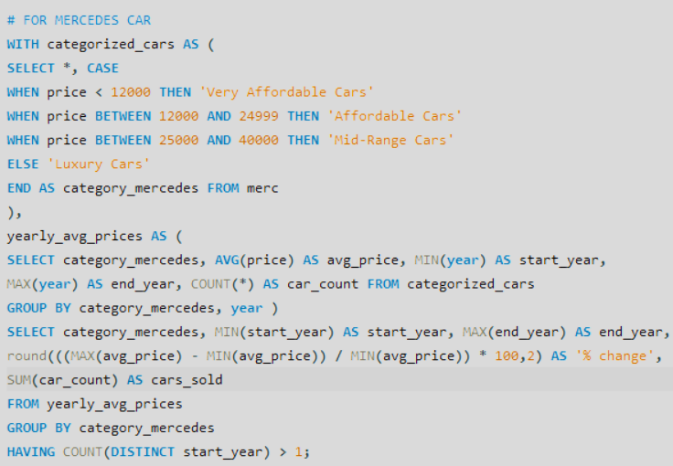
For Mercedes Car

Slide 9
Mercedes

Slide 10
Similarly for Audi

Slide 11
Audi

Slide 12
For BMW

Slide 13
BMW

Slide 14
For Hyundai

Slide 15
Hyundai

Slide 16
Summary
Price Dynamics:
Unearthed significant price jumps in specific categories.
Identified evolving consumer preferences driving pricing trends.
Sales Surges:
Analyzed and identified categories experiencing notable increases in sales.
Established a strong correlation between fuel efficiency and heightened sales.
Fuel Efficiency is an enormous reason between the changes. Premium customers are most cared about Luxurious styles and fuel efficiency is secondary. But for average customers, fuel efficiency is good reason to buy a car. And due to that there are sudden price variation during several years.

Slide 17
Challenges Faced
Employed rigorous data validation techniques.
Tackled complexity in SQL queries with CTEs and Sub-queries.
Prioritized query efficiency for a smoother analysis process.
Categorizing according to price sections was bit difficult but was managed to do by using CTEs and CASE WHEN statement.
Calculation of fuel efficiency and fuel expenditure was very time consuming and led to study more about mileage, fuels, prices and then managed to create a formula. Google also helped to get knowledge about fuel related info.
Utilized Excel for seamless merging and analysis of disparate datasets.

Slide 18
Future Work
Explore predictive modeling to forecast future pricing and sales trends.
Utilize machine learning algorithms for more accurate predictions.
Leveraging additional information, such as environmental factors or location, can enhance forecasting accuracy.
Conduct surveys to gather direct consumer insights on preferences and expectations.
Implement real-time data monitoring to capture emerging trends as they happen.
Understand how international factors influence the automotive market.

